Slide 1

ELL Leadership Academy
Karina E. Chapa, M.Ed.
Language Proficiency, Biliteracy and Cultural Diversity Director
kchapa@esc1.net
Twitter @esc1bilingual @bilingualpride

Slide 2

Professional Learning Essential Agreements
Be respectful of others
Be an active participant
Take care of your needs
Use electronic devices as learning tools

Slide 3
ELL Accountability
Accountability Domains and PBMAS

Slide 4
Session Objectives
Content Objective
Today I will analyze different accountability systems and the impact they have on the instruction of English Learners.
Language Objective
Today I will discuss how different accountability systems impact my school and my district.

Slide 5
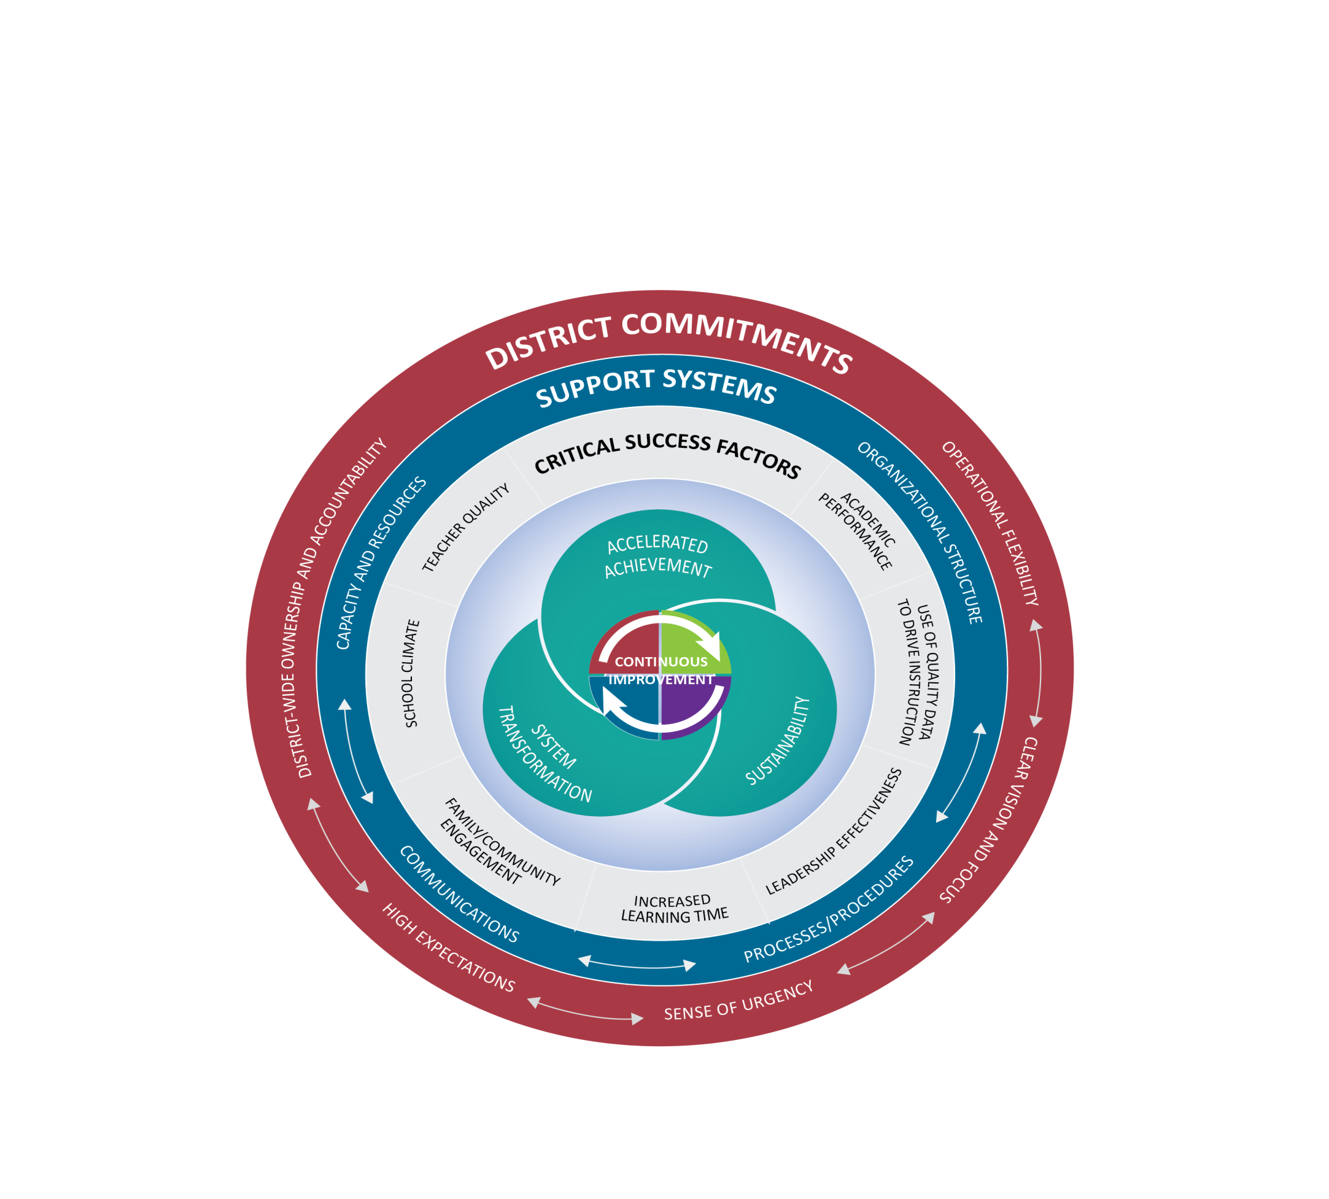
Texas Accountability Intervention System (TAIS)
Notes:
Presenter Talking Points:
The Texas Accountability Intervention System is a research based approached to school improvement that engages the district and school in the improvement process. The framework outlines five systemic components regarding district-level commitments, four support system components to be implemented at both the district and campus levels, and seven factors know to be critical to campus success. Planning for continuous improvement through the lens of these District Commitments, Support Systems and Critical Success Factors will result in the outcomes of accelerated achievement, sustainability, and system transformation.
The Framework for district and school support was developed collaboratively between the TEA and TCDSS. Local ESCs continue to develop tools and support for districts and campuses that align with framework that drives continuous improvement.
All of these elements are part of a healthy system for improvement. It takes each part of the system operating together for school success.
I have a short video to share with you that gives an overview of this framework.

Slide 6
Texas Accountability Intervention System (TAIS)
Notes:
Presenter Talking Points:
The Texas Accountability Intervention System is a research based approached to school improvement that engages the district and school in the improvement process. The framework outlines five systemic components regarding district-level commitments, four support system components to be implemented at both the district and campus levels, and seven factors know to be critical to campus success. Planning for continuous improvement through the lens of these District Commitments, Support Systems and Critical Success Factors will result in the outcomes of accelerated achievement, sustainability, and system transformation.
The Framework for district and school support was developed collaboratively between the TEA and TCDSS. Local ESCs continue to develop tools and support for districts and campuses that align with framework that drives continuous improvement.
All of these elements are part of a healthy system for improvement. It takes each part of the system operating together for school success.
I have a short video to share with you that gives an overview of this framework.

Slide 7
2018 and Beyond
A-F SYSTEM
Implementation of House Bill 22
https://tea.texas.gov/A-F/

Slide 8



A–F Accountability: Legislative Context
HB
2804
HB
22
House Bill 22, 85th Texas Legislature
The commissioner shall evaluate school district and campus performance and assign each district and campus an overall performance rating of
A B C D or F
Notes:
House Bill 22, just like HB 2804 (its predecessor) requires the commissioner to evaluation district and campus performance and assign grades of A, B, C, D, or F.

Slide 9


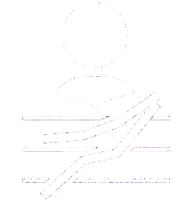
Three Domains: Combining to Calculate Overall Rating
Better of Achievement or Progress
70%
30%
Student Achievement
School
Progress
Closing
The Gaps
Notes:
-To calculate the overall grade, TEA will use the best of the Student Achievement domain or School Progress domain and combine it with the grade of the Closing the Gaps domain, which must account for at least 30% of the overall grade.
-This can only be applied to districts or campuses that do not have an F in either the student achievement or school progress domain. If a district or campus receives an F in either of those two domains, TEA will use a grade of no greater than B for that portion of the overall grade.

Slide 10
A–F Accountability:
New Labels/Grades
A = Exemplary Performance
B = Recognized Performance
C = Acceptable Performance
D = In Need of Improvement
F = Unacceptable Performance

Slide 11


Texas Higher Education Strategic Plan: 2015-2030
Expert Gallery Walk

Slide 12
Student Achievement: Performance
School
Progress
Closing
The Gaps
Student Achievement

Slide 13


Student Achievement: Calculating Score
Texas Higher Education Coordinating Board
By 2030, at least 60 percent of Texans ages 25–34 will have a certificate or degree.
Student Achievement Score
A
 | All Students
Total Tests | 3,212
# Approaches Grade Level or Above | 2,977
# Meets Grade Level or Above | 1,945
# Masters Grade Level | 878
%
%
%
Average of 3
92.7 + 60.6 + 27.3
/ 3
= 60.2
Approaches Grade Level or Above
92.7%
Meets Grade Level or Above
60.6%
Masters Grade Level
27.3%
Notes:
To calculate the STAAR portion of the Student Achievement domain, TEA will average the percentage of students who achieve each of the three performance levels: approaches grade level, meets grade level, and masters grade level.

Slide 14
Student Achievement Domain:
STAAR Component
All tests (STAAR with and without accommodations and STAAR Alternate 2) combined
All subjects combined
Substitute Assessments (at Meets Grade Level)
ELs (except in their first year in US schools*) unless administered a STAAR Alternate 2 assessment.
Three Performance Levels
  Approaches Grade Level and Meets Grade Level are required by HB 22.
  Masters Grade Level standard encourages districts and campuses to push high performing students to excel more.
  The average of three levels is very close to the percentage of students who achieve the Meets Grade Level standard.
  Meets Grade Level equates to a 60% chance of completing one year of college without remediation. Masters equates to a 75% chance.
*Texas had requested a waiver from the U.S. Department of Education to exclude EL students who are year two in U.S. schools from 2018 performance calculations, but it was denied.

Slide 15




Student Achievement: Calculating Score
100%
Elementary School
100%
Middle School
40%
College, Career, Military Ready (CCMR)
Graduation Rates
40%
High School
20%
Notes:
For elementary schools and middle schools, the STAAR is the only component.
For high schools and districts, there are three components: STAAR; college, career, and military ready (CCMR); and graduation rates.

Slide 16
Student Achievement Domain:
STAAR Methodology
STAAR
  One point is given for each percentage of assessment results that are at or above the following*:
  Approaches Grade Level or Above
  Meets Grade Level or Above
  Masters Grade Level
Percentage of Assessments at Approaches Grade Level or Above +
Percentage of Assessments at Meets Grade Level or Above +
Percentage of Assessments at Masters Grade Level
Three
*Substitute assessments are included at the Meets Grade Level standard.

Slide 17



Student Achievement Domain:
CCMR Indicators for HS, K–12, and Districts
College Ready
  Meet criteria of 3 on AP or 4 on IB examinations
  Meet TSI criteria (SAT/ACT/TSIA/College Prep course) in both reading and mathematics
  Complete a course for dual credit
  (9 hours or more in any subject or
  3 hours or more in ELAR/mathematics)
  Earn an associate’s degree
Complete an OnRamps course*
Meet standards on a composite of indicators indicating college readiness*
*Implementation in 2019 & beyond
Career Ready
Earn industry-based certification
CTE coherent sequence coursework completion and credit aligned with approved industry-based certifications
(one-half point credit)
Graduate with completed IEP and workforce readiness (graduation type code of 04, 05, 54, or 55)
Be admitted to postsecondary industry certification program*
Military Ready
Enlist in the United States Armed Forces

Slide 18
School Progress: Growth
Student Achievement
Closing
The Gaps
School Progress
Notes:
The School Progress domain is the second of the three domains established by House Bill 22

Slide 19

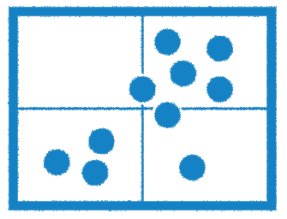
School Progress:
Two Aspects to Progress
Part A: Academic Growth
Part B: Relative Performance
Notes:
When we think about School Progress, we think about the impact on students: how much are they growing
House Bill 22 establishes two ways to evaluation this.
Academic Growth: how much has each individual student grown academically over last year—longitudinal Academic Growth
While this is really good information to have, this metric has some limitations: because there are no STAAR test until third grade, we can’t determine level of growth using this metric until fourth grade, and high school has only a few STAAR test, so it’s not a very effective measure there either.
Relative performance is a different way of looking at growth by comparing the performance of similar campuses against each other.

Slide 20
School Progress:
Two Aspects to Progress
Part A: Academic Growth
Notes:
We’ll start our look at the School Progress domain by exploring Part A: Academic Growth

Slide 21
School Progress Domain, Part A: Academic Growth
Part A: Academic Growth
  It includes all assessments with a STAAR progress measure*.
  Districts and campuses (including high schools) earn credit for results that maintain proficiency or meet growth expectations on STAAR.
  *Substitute assessments are not included.

Slide 22

Academic Growth:
Measuring Advancement
Masters
Exceeds
+ 1 Point Awarded
For meeting or exceeding expected growth
Masters
Meets
Expected
Meets
+ .5 Points Awarded
For maintaining proficiency, but failing to meet expected growth
STAAR Performance Level
Maintains
Approaches
Approaches
Does Not Meet
+ 0 Points Awarded
For falling to a lower level
Does Not Meet
Limited
3rd Grade Example
4th Grade Example
Notes:
Here are a few examples of how Part A works.
The design of the new growth model is to reward students who achieve expected growth (1 point) and also reward students who stay at the same performance level year over year even if they don’t meet growth expectations.
A student who was at Approaches Grade Level last year and achieves the Meets Grade Level this year earns one point
A student who was at Approaches Grade Level last year, stays at Approaches Grade Level this year, but meets the STAAR Progress Measure expectation also earns one point.
A student who was at Approaches Grade Level last year, stays at Approaches Grade Level this year, but does not meet the STAAR Progress Measure expectation earns half a point for maintaining proficiency.
And a student who moves to a lower performance level between years earns no points.
We no longer award two points for exceeding STAAR Progress Measure expectations. This is very different from what we’ve done in recent years.

Slide 23
Academic Growth:
Percentage of Students Gaining
STAAR
Current Year
 | Did Not Meet Grade Level | Approaches Grade Level | Meets Grade Level | Masters Grade Level
Did Not Meet Grade Level | Met/Exceeded Growth Measure = 1 pt Did not meet = 0 pts | Met/Exceeded Growth Measure = 1 pt Did not meet = .5 pts | 1 pt | 1 pt
Approaches Grade Level | Met/Exceeded Growth Measure = 1 pt Did not meet = 0 pts | Met/Exceeded Growth Measure = 1 pt Did not meet = .5 pts | 1 pt | 1 pt
Meets Grade Level | 0 pts | 0 pts | Met/Exceeded Growth Measure = 1 pt Did not meet = .5 pts | 1 pt
Masters Grade Level | 0 pts | 0 pts | 0 pts | 1 pt
Previous Year

Slide 24
School Progress:
Two Aspects to Progress
Part B: Relative Performance
Notes:
Part B of this domain looks at relative performance.

Slide 25
Relative Performance:
Measuring School Progress
Part B: Relative Performance
  It evaluates the achievement of all students relative to districts or campuses with similar socioeconomic statuses.

Slide 26
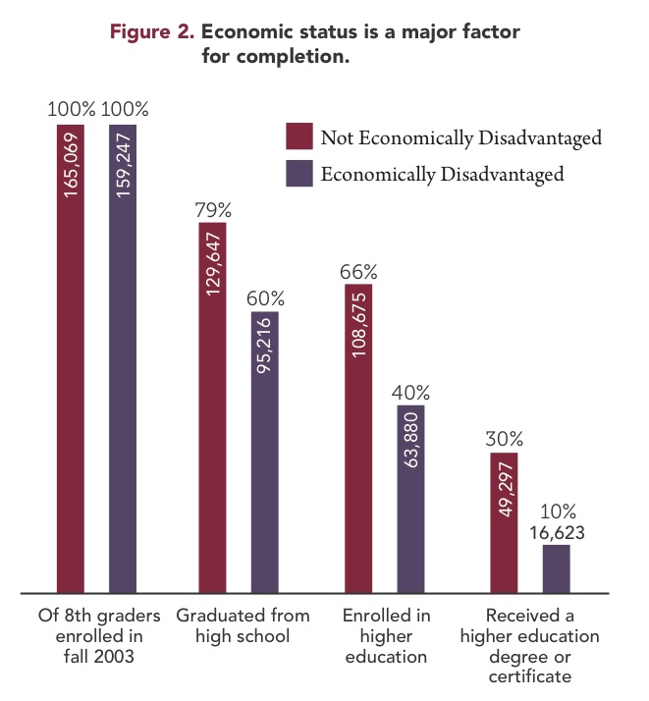
School Progress:
Two Aspects to Progress
Notes:
Part B of this domain looks at relative performance.

Slide 27
Relative Performance: Measuring School Progress
Higher Levels
of Student
Achievement
A campus with fewer economically disadvantaged students on average has higher levels of student achievement.
STAAR and CCMR Results for All Students
A campus with more economically disadvantaged students tends to have lower levels of student achievement.
Includes STAAR and CCMR for districts and campuses that have that data
Average Line
Higher Rates of
Economically
Disadvantaged Students
% Economically Disadvantaged Students
Notes:
We know that, generally, a campus with fewer economically disadvantaged students has higher levels of student achievement.
And, generally, a campus with more economically disadvantaged students tends to have lower levels of student achievement.
But poverty is not destiny.

Slide 28
Relative Performance: Measuring School Progress
Higher Levels
of Student
Achievement
A
STAAR and CCMR Results for All Students
B
C
D
F
Higher Rates of
Economically
Disadvantaged
% Economically Disadvantaged Students
Notes:
From that average line, we draw bands that determine grades.
We’re still working to determine where the cut points should be.
The slope of the lines will all be the same; grades will be determined by how far above or below the average line a district or campus falls.
This is an area where we would like feedback
When we run this for accountability, we’re planning several different scatterplots: one for elementary schools, one for middle schools, one for high schools/K–12, one for AEAs and one for districts.
We’ve looked at whether to use other characteristics in addition to percentage of economically disadvantaged students (English learners, Special Ed, etc.), but research has shown that the one characteristic that matters more than any other is the percentage of economically disadvantaged students.
We’re going to fix a distribution for the 2017–18 school year using data from 2016–17 accountability, then we’ll hold those cut points for hopefully five years.

Slide 29
Closing the Gaps:
Ensuring Educational Equity
Student Achievement
School
Progress
Closing
The Gaps
Notes:
A quick review: The new accountability system has three domains: Student Achievement, School Progress, and Closing the Gaps.
To calculate the overall grade, we’ll take the best of the first two domains and combine that grade with the grade in the Closing the Gaps domain.
A campus that earns a grade of C, B, or A is eligible to be assigned a grade based, in part, on a local accountability system.
Today, we’re going to explore the Closing the Gaps domain.

Slide 30

Closing the Gaps:
Aligning Accountability Systems
Closing
The Gaps
Notes:
For the first time in 15 years, we will have only one accountability system. Federal and state requirements both will be met in our new accountability system. The Closing the Gaps domain will be used to meet ESSA requirements.

Slide 31






Closing the Gaps:
Ensuring Educational Equity
All Students
Continuously Enrolled
and Mobile
English
Learners (ELs)
Economically
Disadvantaged
Race/Ethnicity
Special Education
x
x
Notes:
This domain disaggregates data by student group, and is how we are planning to meet the requirements of ESSA
For this domain, we will look at fifteen individual student groups.

Slide 32


Closing the Gaps Domain:
Ensuring Educational Equity
Student Groups
All Students
African American
Hispanic
White
American Indian
Asian
Pacific Islander
Two or More Races
Economically Disadvantaged
Current and Former Special Education
Current and Monitored English Learners
Continuously Enrolled/Non-Continuously Enrolled
Components
Academic Achievement in Reading and Mathematics (At Meets Grade Level or Above)
  Growth in Reading and Mathematics (Elementary and Middle Schools)
  4-year Federal Graduation Rate
  (High Schools, K–12, and Districts)
  College, Career, and Military Readiness
  (High Schools, K–12, and Districts)
  Student Achievement Domain Score:
  STAAR Component Only
  (Elementary and Middle Schools)
  English Language Proficiency Status
  (Requested one-year waiver, but it was denied)
Notes:
Continuously Enrolled: Definition?

Slide 33
Closing the Gaps Domain: Components
Academic Achievement*
  STAAR performance (percentage at Meets Grade Level or Above)
  ELA/Reading
  Mathematics
  Targets
  By student group and subject area
  *Substitute assessments are included at the Meets Grade Level standard.

Slide 34
Closing the Gaps Domain: Components
Growth
  Elementary and Middle Schools (School Progress Domain)
    ELA/Reading
    Mathematics
  Graduation Rate
  High Schools, K–12, Districts
    4-year Federal Graduation Rate (without exclusions)
  Targets
  By student group
  For Growth, by subject area

Slide 35
Closing the Gaps Domain: Components
School Quality and Student Success
  High Schools, K–12, and Districts
    College, Career, and Military Readiness*
  Elementary and Middle Schools
    Student Achievement Domain Score: STAAR Only
  Targets
  By student group
  Evaluates annual graduates plus students in grade 12 during school year 2016–­17 as reported in TSDS PEIMS who did not graduate.

Slide 36






Closing the Gaps Domain: Calculating a Rating
Student Group
Achievement Target
% of Student Groups
that Meet Target
Overall
Component
Score

Slide 37
Closing the Gaps Domain: Weighting
Elementary/Middle Schools Weight*
  Academic Achievement 30%
  Academic Growth Status 50%
  Student Achievement Domain Score: 10%
  STAAR Component Only
  English Language Proficiency 10%

Slide 38
Closing the Gaps Domain: Weighting
High Schools, K–12, AEAs, and Districts Weight*
  Academic Achievement 50%
  Federal Graduation Status 10%
  (Academic Growth Status if not available)
  College, Career, and Military Readiness 30%
  (Student Achievement Domain Score:
  STAAR Component Only if not available)
  English Language Proficiency 10%

Slide 39
Closing the Gaps:
Student Groups
Current and Former Special Education
Defined by HB 22
Formerly receiving special education services
  The student was reported in PEIMS the preceding year as enrolled at the campus and participating in a special education program.
  The student is reported (PEIMS and STAAR answer documents) as enrolled at the campus in the current year and not participating in a special education program.
  Current modeling shows that this affects approximately 110 districts and six campuses when a the minimum-size criteria of 25 is applied.
Notes:
Let’s take a look at a few of the new student groups that we will be using: House Bill 22 requires tracking current and former Special Ed students.
This will be the first time that former special education students are looked as a student group in the accountability system.
The challenge is that there are rarely enough kids to measure this at the campus level. Currently modeling shows us that, when minimum-size criteria is applied, only six campuses and 110 districts has sufficient data for this indicator. Our current modeling uses two years of former special education data. This is a feedback opportunity: for how long in the past should we look to include them in this group? Two, three, four, more?

Slide 40
Closing the Gaps:
Student Groups
Continuously Enrolled and Non-Continuously Enrolled
Not defined by HB 22
Districts
  Grades 4–12: Enrolled at a district in the fall snapshot in the current school year and each of the three previous years
  Grade 3: Enrolled at a district in the fall snapshot in the
  current school year and each of the previous two years
  Campuses
  Grades 4–12: Enrolled at a campus in the fall snapshot in the current school year and in the same district in each of the three previous years
  Grade 3: Enrolled at a campus in the fall snapshot in the current school year and in the same district each of the previous two years
Notes:
HB 22 also requires us to look at students who are continuously enrolled.
This is a tentative definition and we welcome feedback on how to improve it. This is a difficult measure especially at the campus level because of the number of different grade spans that the 8,600 or so campuses in Texas serve.
Here is how it works for districts: If a student in fourth grade or higher is in the district on the snapshot date, we look at back at each of the previous three years (four years total) to see if there were in the district on the snapshot date in each of those years. If he or she was, then he or she is counted as continuously enrolled. If not then the student is not counted as continuously enrolled. For students that are in third grade, we look at the current year and the previous two. Students in kindergarten, first grade, and second grade are not considered continuously enrolled.
Here is how it works for campus: If a student in fourth grade or higher is on the campus on the snapshot date, we look at back at each of the previous three years (four years total) to see if there were in the district on the snapshot date in each of those years. A student on a campus on the snapshot date and in the district in each of the previous three years is counted as continuously enrolled for the campus. If not then the student is not counted as continuously enrolled. For students that are in third grade, we look at the current year and the previous two. Students in kindergarten, first grade, and second grade are not considered continuously enrolled.

Slide 41




Closing the Gaps:
Continuously Enrolled in District
2017
2016
2015
2014
10th Grade
9th Grade
8th Grade
7th Grade
Continuously Enrolled
Notes:
Here’s an example for a district. Moving left to right, the student is in the district on the snapshot date in 2017 and was also in the PEIMS snapshot for the previous three years. This student is considered continuously enrolled.

Slide 42
Closing the Gaps:
Continuously Enrolled in District
2017
2016
2015
2014
10th Grade
9th Grade
8th Grade
Non-Continuously Enrolled
Notes:
Moving left to right, this student was in the district on the snapshot date in 2017 (10th grade) and was also in the PEIMS snapshot for only the previous two years. This student is considered non-continuously enrolled.

Slide 43
Closing the Gaps:
Continuously Enrolled in District
2017
2016
2015
3rd Grade
2nd Grade
1st Grade
Continuously Enrolled
Notes:
If, however, the student is in the third grade in the current year, we look back only two years. This student is considered continuously enrolled.

Slide 44
Closing the Gaps:
Continuously Enrolled in District
2017
2016
2015
3rd Grade
1st Grade
Non-Continuously Enrolled
Notes:
The 3rd grader in this slide is considered non-continuously enrolled because he or she does not have three continuous years in the district.

Slide 45

Closing the Gaps:
Continuously Enrolled at a Campus
2017
2016
2015
2014
10th Grade
9th Grade
8th Grade
7th Grade
Continuously Enrolled
Notes:
Here’s an example for a campus. Moving left to right, the student is on the campus on the snapshot date in 2017 and was also in the PEIMS snapshot for the district for the previous three years. This student is considered continuously enrolled.

Slide 46
Closing the Gaps:
Continuously Enrolled at a Campus
2017
2016
2015
2014
10th Grade
9th Grade
8th Grade
Non-Continuously Enrolled
Notes:
Moving left to right, this student was on the campus on the snapshot date in 2017 (10th grade) and was also in the PEIMS snapshot for the district for only the previous two years. This student is considered non-continuously enrolled.

Slide 47
Closing the Gaps:
Continuously Enrolled at a Campus
2017
2016
2015
3rd Grade
2nd Grade
1st Grade
Continuously Enrolled
Notes:
If, however, the student is in the third grade in the current year, we look back only two years. This student is considered continuously enrolled.

Slide 48
Closing the Gaps:
Continuously Enrolled at a Campus
2017
2015
3rd Grade
1st Grade
Non-Continuously Enrolled
Notes:
The 3rd grader in this slide is considered non-continuously enrolled because he or she does not have three continuous years in the district.

Slide 49
Inclusion of English Learners in 2018 Accountability and Beyond
  English Learners (ELs) who are year one in U.S. schools are excluded from accountability performance calculations.
  Due to changes to the Texas English Language Proficiency Assessment System (TELPAS), Texas requested a waiver from the U.S. Department of Education to exclude EL students who are year two in U.S. schools from 2018 performance calculations. Waiver was denied, so ELs who are in their second year in U.S. schools were included in accountability for 2018 and beyond.
  STAAR Alternate 2 assessment results are included regardless of an EL’s years in U.S. schools.
  In 2018, the STAAR progress measure was used for ELs and non-ELs in the School Progress, Part A domain.
  Asylees, refugees, and students with interrupted formal education (SIFEs) are not included in state accountability until their sixth year of enrollment in U.S. schools.

Slide 50
Academic Achievement
Academic Achievement*
  STAAR performance (percentage at Meets Grade Level or Above)
  ELA/Reading
  Mathematics
  Targets by student group and subject area
  Districts/campuses must have 10 reading and 10 mathematics assessment results for all students in the Academic Achievement component to be evaluated on the Closing the Gaps domain.
  Must have a minimum of five indicators that meet minimum size to be evaluated on the Closing the Gaps domain.
  *Substitute assessments are included at the Meets Grade Level standard.

Slide 51
Academic Achievement: District Example
Notes:
Elementary School Weight

Slide 52
Growth/Graduation Rate
  Federal Graduation Status
  High Schools, K–12, Districts
    4-year Federal Graduation Rate (without exclusions)
    Targets by student group
    Must have at least one indicator that meets minimum size
    If Federal Graduation Status is not available, Academic Growth Status will be used.

Slide 53
Federal Graduation Status: District Example
Notes:
High School Weight

Slide 54
School Quality and Student Success
    Student Success
  Elementary and Middle Schools*
    Student Achievement Domain Score: STAAR Only
    Targets by student group
    Must have a minimum of five indicators that meet minimum size
    * If Federal Graduation Status is not available for a high school, K–12, or district Academic Growth Status will be used.

Slide 55
School Quality: District Example

Slide 56
Domain III: Closing the Gaps

Slide 57

TAPR Reports
https://tea.texas.gov/perfreport/tapr/index.html

Slide 58
Ratings

Slide 59
Calculating an Overall Rating
Better of Achievement or Progress
70%
30%
Student Achievement
School
Progress
Closing
The Gaps

Slide 60
Calculating an Overall Rating: Scaling
Districts
  Scaled scores were created to align letter grades and scores used in the A–F academic accountability system to the common conception of letter grades.
Campuses
  Scaled scores were established by campus type.

Slide 61
Calculating an Overall Rating: Weighting
  Step 1: Determine the better outcome of the Student Achievement and the School Progress domain scaled scores.
  Step 2: Weight the better outcome of the Student Achievement or the School Progress domain scaled score at 70 percent.
  Step 3: Weight the Closing the Gaps domain scaled score at 30 percent.
  Step 4: Total the weighted outcome of the two scaled scores to calculate the overall score.

Slide 62
Calculating an Overall Rating: Example
Domain | Scaled Score | Better of School Progress Part A or Part B | Better of Student Achievement or School Progress | Weight | Weighted Points
Student Achievement | 89 |  | 89 | 70% | 62.3
School Progress, Part A | 84 | 84
School Progress, Part B | 72
Closing the Gaps | 81 |  |  | 30% | 24.3
Overall Score |  |  |  |  | 87
2018 District Overall Rating |  |  |  |  | B

Slide 63
2018 Rating Labels
Districts
  A, B, C, or D: Assigned for overall performance and for performance in each domain to districts that meet the required performance target for the letter grade
  F: Assigned for overall performance and for performance in each domain to districts (including AEAs) that do not meet the required performance target to earn at least a D
  Not Rated: Assigned to districts that—under certain, specific circumstances—do not receive a rating

Slide 64
2018 Rating Labels
Campuses
  Met Standard: Assigned for overall performance and for performance in each domain to campuses that meet the required performance targets
  Improvement Required: Assigned for overall performance and for performance in each domain to campuses (including AEAs) that do not meet the required performance targets
  Met Alternative Standard: Assigned for overall performance and for performance in each domain to alternative education campuses evaluated under alternative education accountability (AEA) provisions that meet the required performance targets
  Not Rated: Assigned to campuses that—under certain, specific circumstances—do not receive a rating

Slide 65
State Accountability Videos
https://tea.texas.gov/A-F/

Slide 66
Let’s Reflect!
In your opinion, what is the biggest change in the state accountability system?
How is this change going to impact what you do at your district?
What is the number one thing you have to do differently under this new system?

Slide 67
Session Objectives
Content Objective
Today I analyzed different accountability systems and the impact they have on the instruction of English Language Learners.
Language Objective
Today I discussed how different accountability systems impact my school and my district.

Slide 68
Mil Gracias
See you 04/27!
Karina E. Chapa, M.Ed.
Language Proficiency, Biliteracy and Cultural Diversity Director
kchapa@esc1.net
Facebook: Region One ESC Bilingual
Twitter @esc1bilingual @bilingualpride

